Slide 1
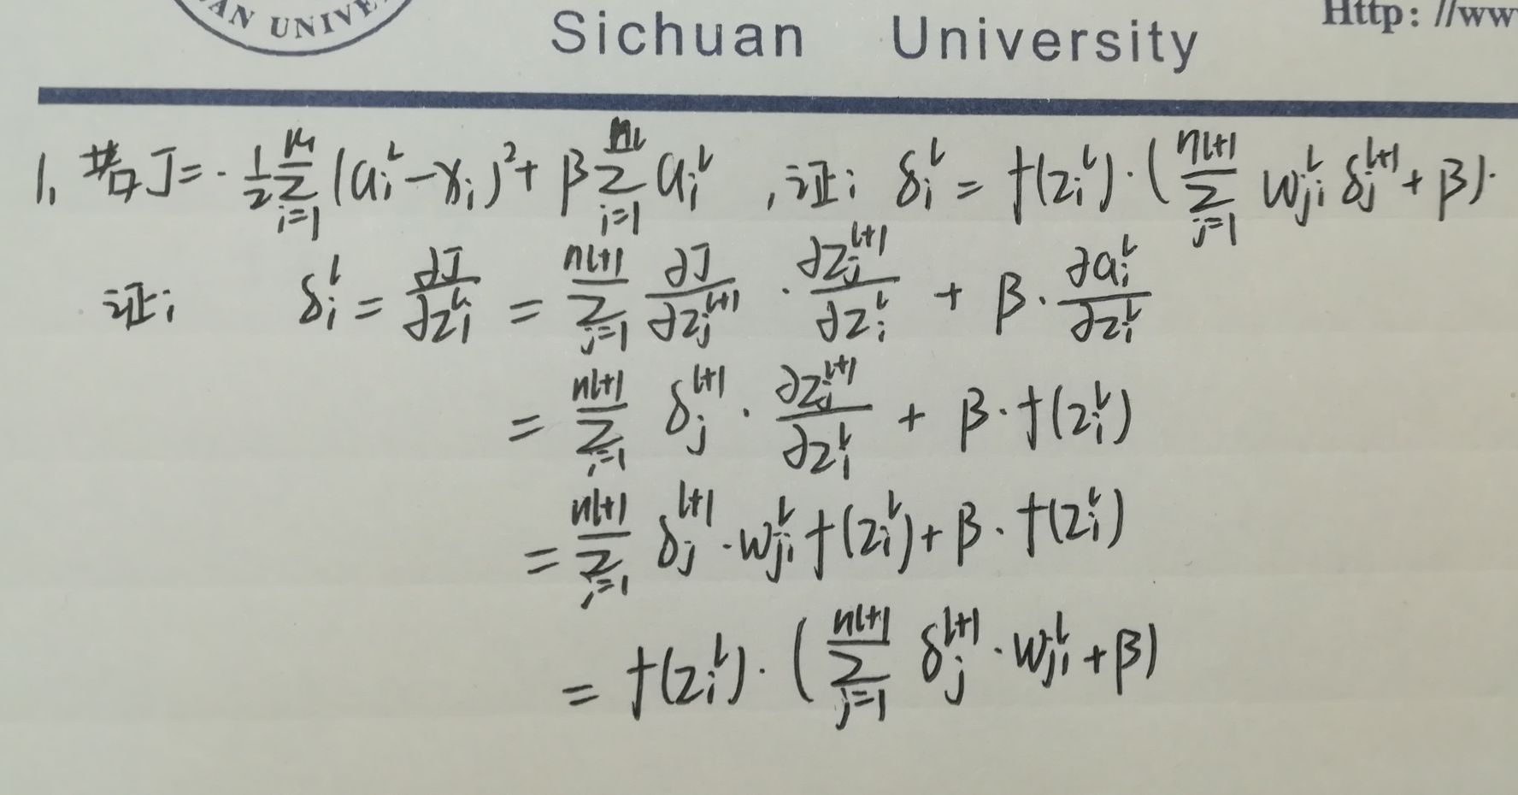
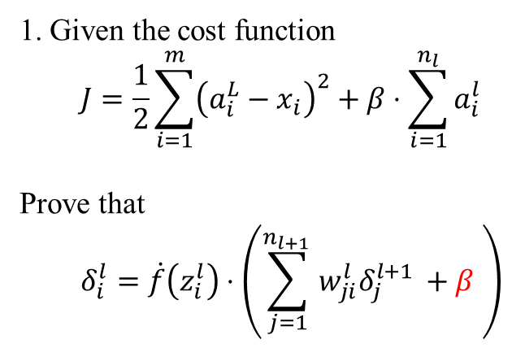
1. Given the cost function
$$J=\frac{1}{2}\sum_{i=1}^{m}{{\left(a_{i}^{L}−x_{i}\right)}^{2}}+β⋅\sum_{i=1}^{n_{l}}{a_{i}^{l}}$$
Prove that
$$δ_{i}^{l}=\dot{f}\left(z_{i}^{l}\right)⋅\left(\sum_{j=1}^{n_{l+1 }}{w_{ji}^{l}δ_{j}^{l+1 }}+β \right)$$
Your answer here
Answer with digital formulation or take a picture of your handcraft manuscript.

Slide 2
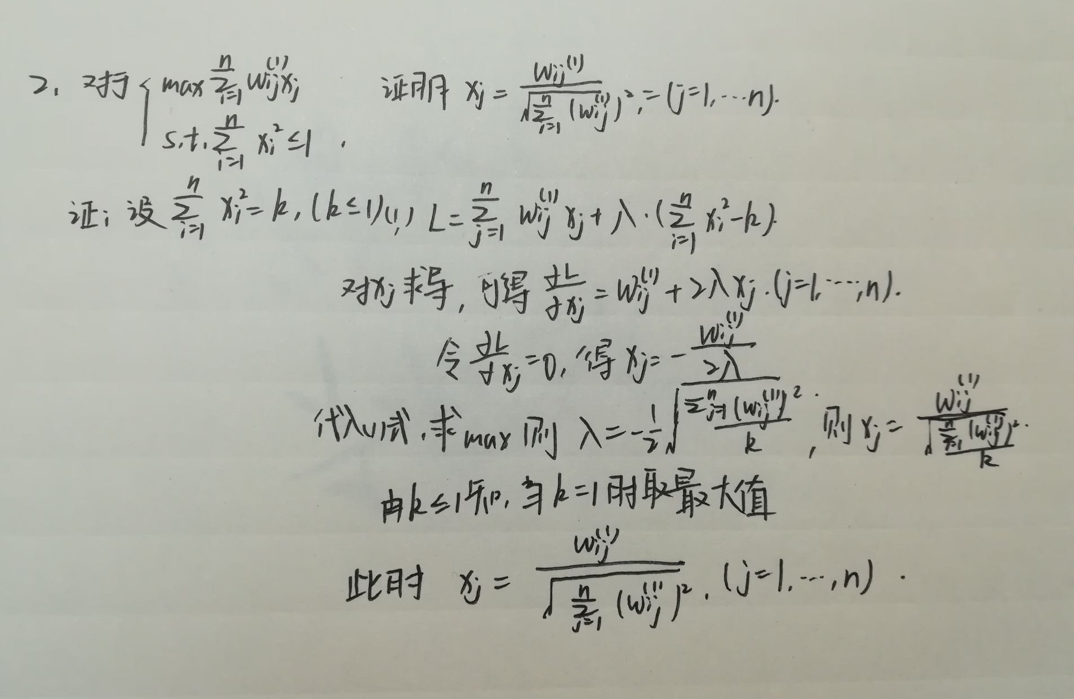
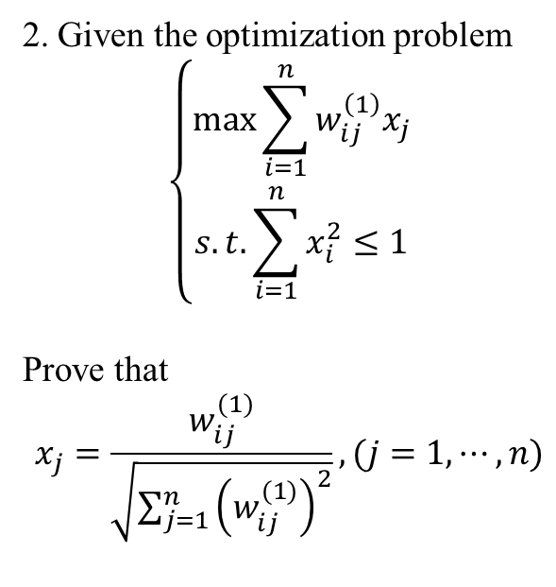
2. Given the optimization problem
$$\left\{\begin{aligned}\max{\sum_{i=1}^{n}{w_{ij}^{\left(1\right)}x_{j}}} \\ s.t. \sum_{i=1}^{n}{x_{i}^{2}}≤1\end{aligned}\right.$$
Prove that
$$x_{j}=\frac{w_{ij}^{(1)}}{\sqrt{\sum_{j=1}^{n}{{\left(w_{ij}^{(1)}\right)}^{2}}}}, (j=1,⋯, n)$$
Your answer here
Answer with digital formulation or take a picture of your handcraft manuscript.

